Slide 1
Data Science for Mining Patterns in Spatial Events
Student: Xun Tang
Advisor: Prof. Shashi Shekhar
Thesis Committee:
Prof. Shashi Shekhar Prof.George Karypis
Prof. Singdhansu Chatterjee Prof. Ravi Janardan

Slide 2
Biography
Education
Ph.D. Computer Science, University of Minnesota, Fall 2013 – Present
M.E. Computer Science, Harbin Institute of Technology, China, 2013
B.E. Computer Science, Harbin Institute of Technology, China, 2011
Professional Experience
Research assistant
Spatial computing research group
Teaching assistant
CSCI 5715: Spatial Computing
CSCI 2033: Elementary Linear Algebra
Software Engineer Intern at Facebook
Awards
UMN Doctoral Dissertation Fellowship, 2018 - 2019.
Mentor, Scholar of Distinction in Mathematics and Applied Geography, Wayzata High School

Slide 3
Thesis related publications
Tang, X., Sharma, A., and Shekhar, S., 2019. Spatio-temporal Intersection Detection From Trajectories With Data Gaps: A Summary of Results (Submitted to 16th International Symposium on Spatial and Temporal Databases, 2019)
Tang, X., Eftelioglu, E., Oliver, D. and Shekhar, S., 2017. Significant Linear Hotspot Discovery. IEEE Transactions on Big Data, 3(2), pp.140-153.
Tang, X., Eftelioglu, E. and Shekhar, S., 2017, August. Detecting Isodistance Hotspots on Spatial Networks: A Summary of Results. In International Symposium on Spatial and Temporal Databases (pp. 281-299), LNCS 10411, Springer, Cham.
Tang, X., Eftelioglu, E. and Shekhar, S., 2015, November. Elliptical hotspot detection: a summary of results. In Proceedings of the 4th International ACM SIGSPATIAL Workshop on Analytics for Big Geospatial Data (pp. 15-24). ACM.”
Geographically Robust Hotspot Detection”, Emre Eftelioglu, Xun Tang, Shashi Shekhar, ICDM 2015 workshop on Spatial and Spatiotemporal Data Mining, 2015.
Eftelioglu, E., Li, Y., Tang, X., Shekhar, S., Kang, J.M. and Farah, C., 2016, September. Mining Network Hotspots with Holes: A Summary of Results. In International Conference on Geographic Information Science (pp. 51-67), LNCS 9927, Springer.

Slide 4
More publications
Eftelioglu, E., Tang, X., and Shekhar, S., 2018, May. Avoidance region discovery: A summary of results. In Proceedings of the 2018 SIAM International Conference on Data Mining (pp. 585-593). Society for Industrial and Applied Mathematics.
Shekhar, S., Li, Y., Ali, R.Y., Eftelioglu, E., Tang, X. and Jiang, Z., 2018. Spatial and Spatiotemporal Data Mining. Elsevier.
Xie, Y., Eftelioglu, E., Ali, R.Y., Tang, X., Li, Y., Doshi, R. and Shekhar, S., 2017. Transdisciplinary Foundations of Geospatial Data Science. ISPRS International Journal of Geo-Information, 6(12), p.395. MDPI
Shekhar, S., Li, Y., Xie, Y., Tang, X., Ali, R.Y. and Eftelioglu, E., 2017. Geospatial Data Science: A Transdisciplinary Approach. In Geospatial Data Science Techniques and Applications (pp. 1-40). CRC Press.
Eftelioglu, E., Jiang, Z., Tang, X. and Shekhar, S., 2017. The Nexus of Food, Energy, and Water Resources: Visions and Challenges in Spatial Computing. In Advances in Geocomputation (pp. 5-20). Springer, Cham.
Eftelioglu, E., Shekhar, S. and Tang, X., 2016. Crime Hotspot Detection: A Computational Perspective. In Data Mining Trends and Applications in Criminal Science and Investigations (pp. 82-111). IGI Global. ISBN-13: 978-1522504634
Shekhar, S., Jiang, Z., Ali, R.Y., Eftelioglu, E., Tang, X., Gunturi, V. and Zhou, X., 2015. Spatiotemporal data mining: a computational perspective. ISPRS International Journal of Geo-Information, 4(4), pp.2306-2338.
Samsonov, P.A., Tang, X., Schöning, J., Kuhn, W. and Hecht, B., 2015, April. You Can't Smoke Here: Towards Support for Space Usage Rules in Location-aware Technologies. In Proceedings of the 33rd annual ACM conference on human factors in computing systems (pp. 971-974). ACM
Tang, X., Zhang, S. and Yao, H., 2013, September. Sparse coding based motion attention for abnormal event detection. In Image Processing (ICIP), 20th International Conference on (pp. 3602-3606). IEEE.
Tang, X., 2012, May. Book retrieval based on Near-Duplicate image matching. 9th International Conference on Fuzzy Systems and Knowledge Discovery (FSKD), (pp. 2616-2619). IEEE.

Slide 5



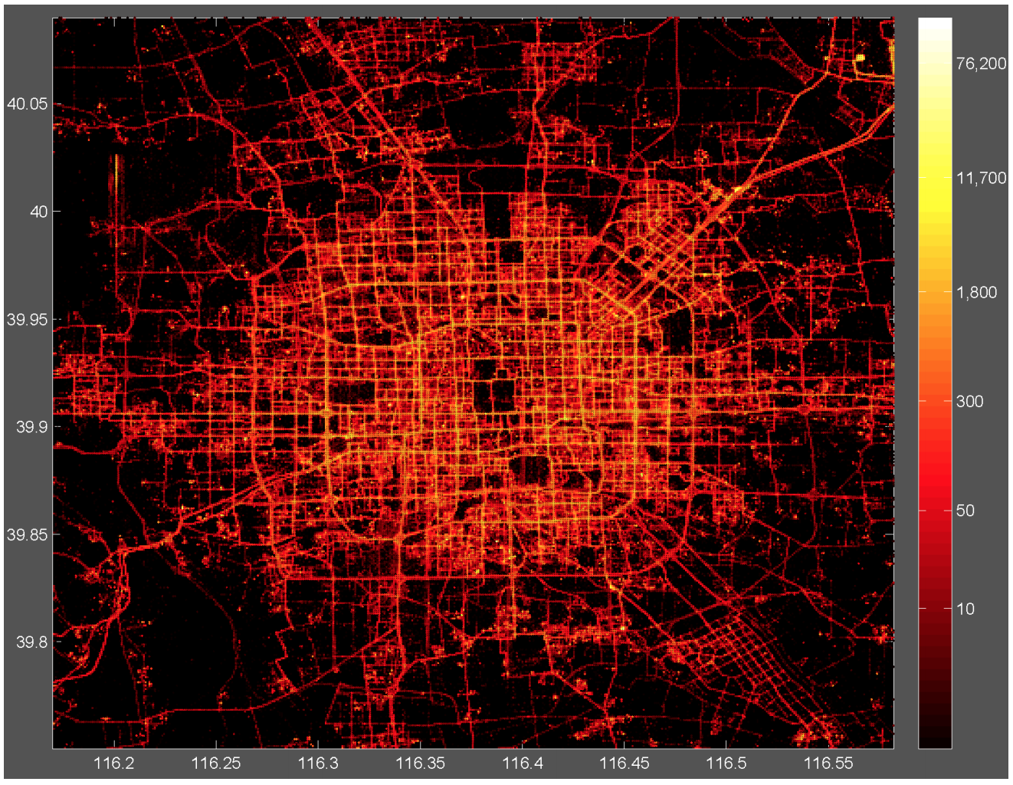
Overview - growth of spatial data
Billions of GPS devices cause explosive growth of spatial data
Quote: “Big data offers considerable benefits to consumers as well as to companies and organizations. For instance, services enabled by personal-location data can allow consumers to capture $600 billion in economic surplus” – McKinsey Global Institute
https://www.mckinsey.com/business-functions/digital-mckinsey/our-insights/big-data-the-next-frontier-for-innovation
Microsoft AI for Earth
https://aws.amazon.com/earth/
https://www.microsoft.com/en-us/ai/ai-for-earth?activetab=pivot1%3aprimaryr6
Beijing taxi heat map
https://www.microsoft.com/en-us/research/publication/t-drive-trajectory-data-sample/

Slide 6
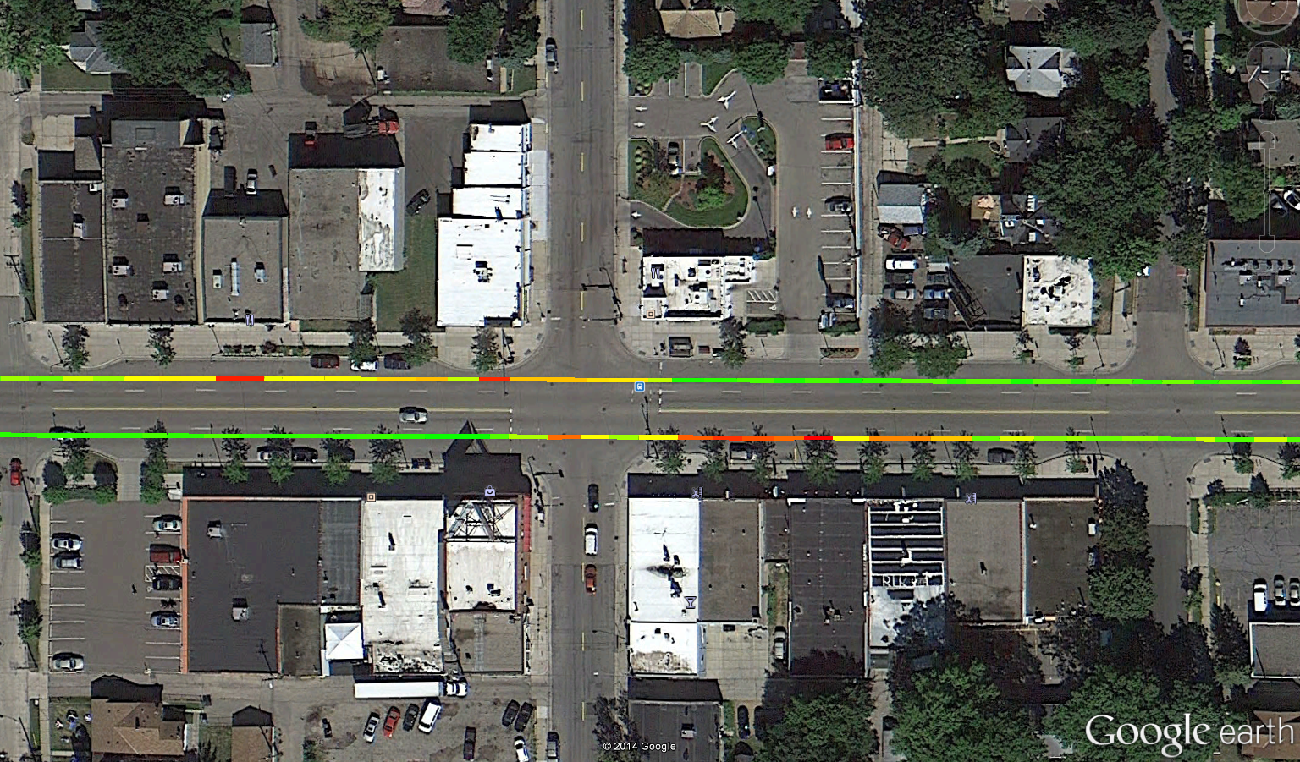
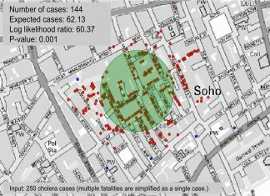


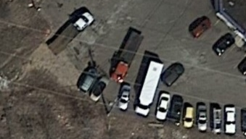
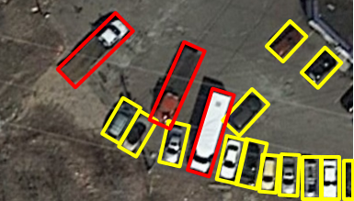

Overview – spatial data mining
Process of identifying interesting, useful, and non-trivial patterns from large spatial dataset
Spatial pattern families:
Hotspots, spatial clusters
Spatial outliers, discontinuities
Colocations, co-occurrences
Classification, prediction
Object detection
…
Spatial data tools:
Colocation: high emission after bus stops
Hotspot: London cholera outbreak in 1854
Object detection:
car
truck
Input test image
Output vehicles

Slide 7
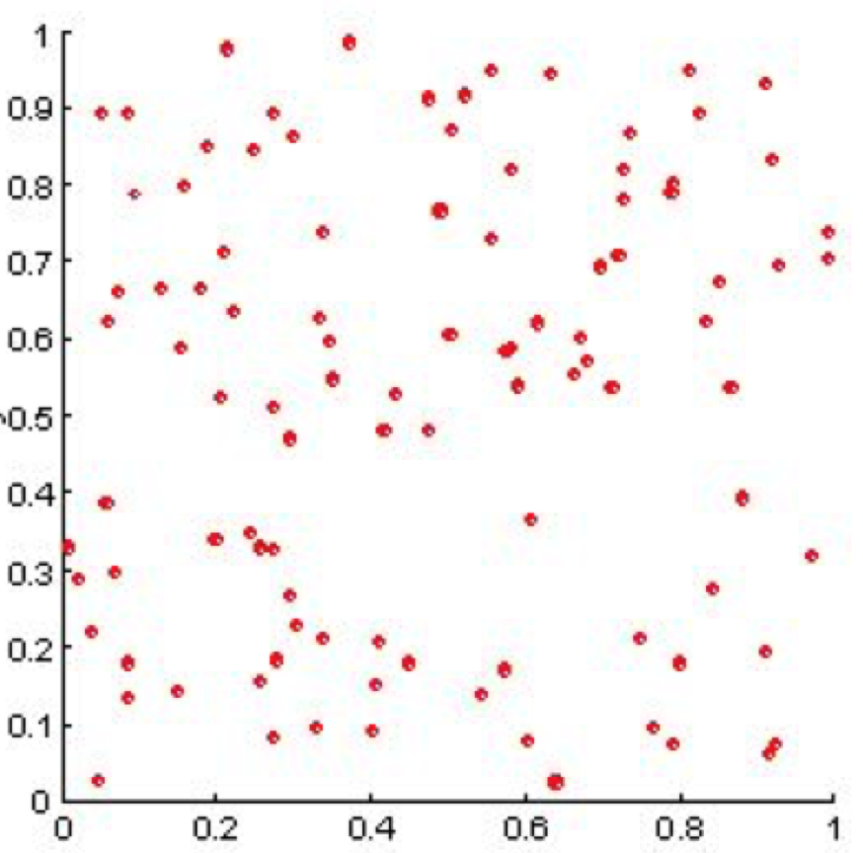
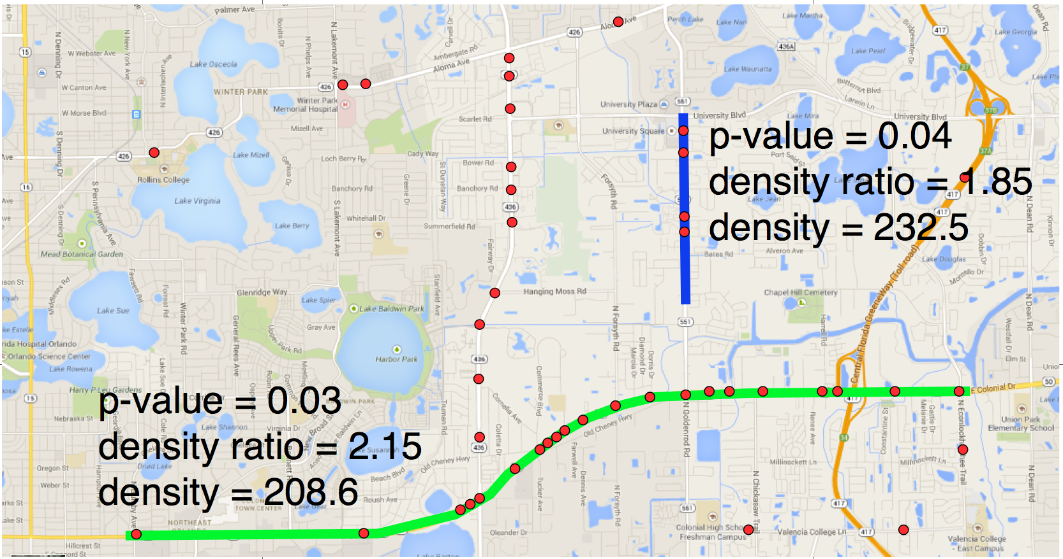
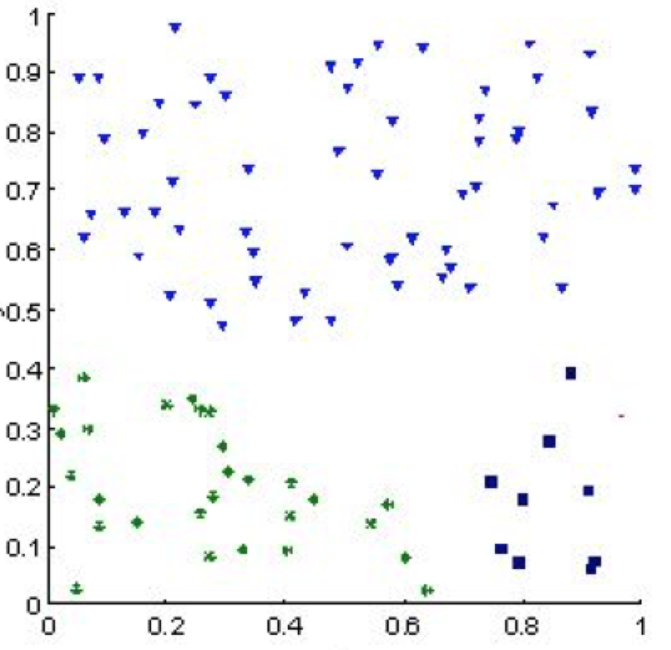
Overview – challenges
Spatial data mining poses unique data science challenges [1]
Cost of false positives
Multi-scale data
Gerrymandering dilemma
In many applications, false positives cause unacceptable consequences
Approaches with statistical significance test (e.g., SaTScan) are proposed to eliminate false positives
Circular hotspots by SaTScan
Complete Spatial Random data
No hotspot
Example linear hotspots
Circle and linear hotspots on Pedestrian fatality data in Orlando, FL
SaTScan
DBScan
[1] A UCGIS Call to Action: Bringing the Geospatial Perspective to Data Science Degrees and Curricula, University Consortium for Geographic Information Science, 2018

Slide 8
Thesis contributions – a taxonomy
This thesis investigates computational approaches to mine multiple spatial patterns
Categorized based on types of input and output footprints
Overcome different computational challenges
 |  | Output pattern footprint
 |  | Point | Linear |  |  | Areal
 |  |  | Shortest paths | Simple paths | All paths
Input footprint | Spatial point event |  | Linear hotspots on shortest paths (Ch. 2) | Linear hotspots on all simple paths (Ch. 3)
 | ST point event
 | ST linear event in trajectory |  |  |  |  | ST Intersections (Ch. 4)
 | ST event in areal data
ST: Spatio-temporal

Slide 9
Thesis contributions – defense focus
Linear hotspots discovery on shortest paths (Ch. 2)
Explore dynamic segmentation model
Propose neighbor node filter and shortest path tree pruning algorithms
Theoretical and experimental evaluations
Linear hotspots discovery on all simple paths (Ch. 3)
Propose a bi-directional fragment-multi-graph traversal algorithm (ASP_FMGT)
Propose mono-directional FMGT which improves over ASP_FMGT (ASP_FMGT_Mono)
Propose two paths reduction approaches ASP_NR and ASP_HD that further improve scalability selectively enumerate simple path
Theoretical and experimental evaluations
Spatio-temporal intersection detection from trajectories with data gaps (Ch. 4)
Explore clandestine patterns from data gaps due to deliberately switched off GPS devices
Define spatio-temporal intersection pattern based on prism model in time geography
Propose an apriori-graph traversal algorithm
Theoretical and experimental evaluations
Defense focus
After thesis proposal

Slide 10
Outline: Linear hotspots discovery on all simple paths
Motivation
Problem Statement
Challenges
Related Work
Contributions
Validation
Conclusion

Slide 11
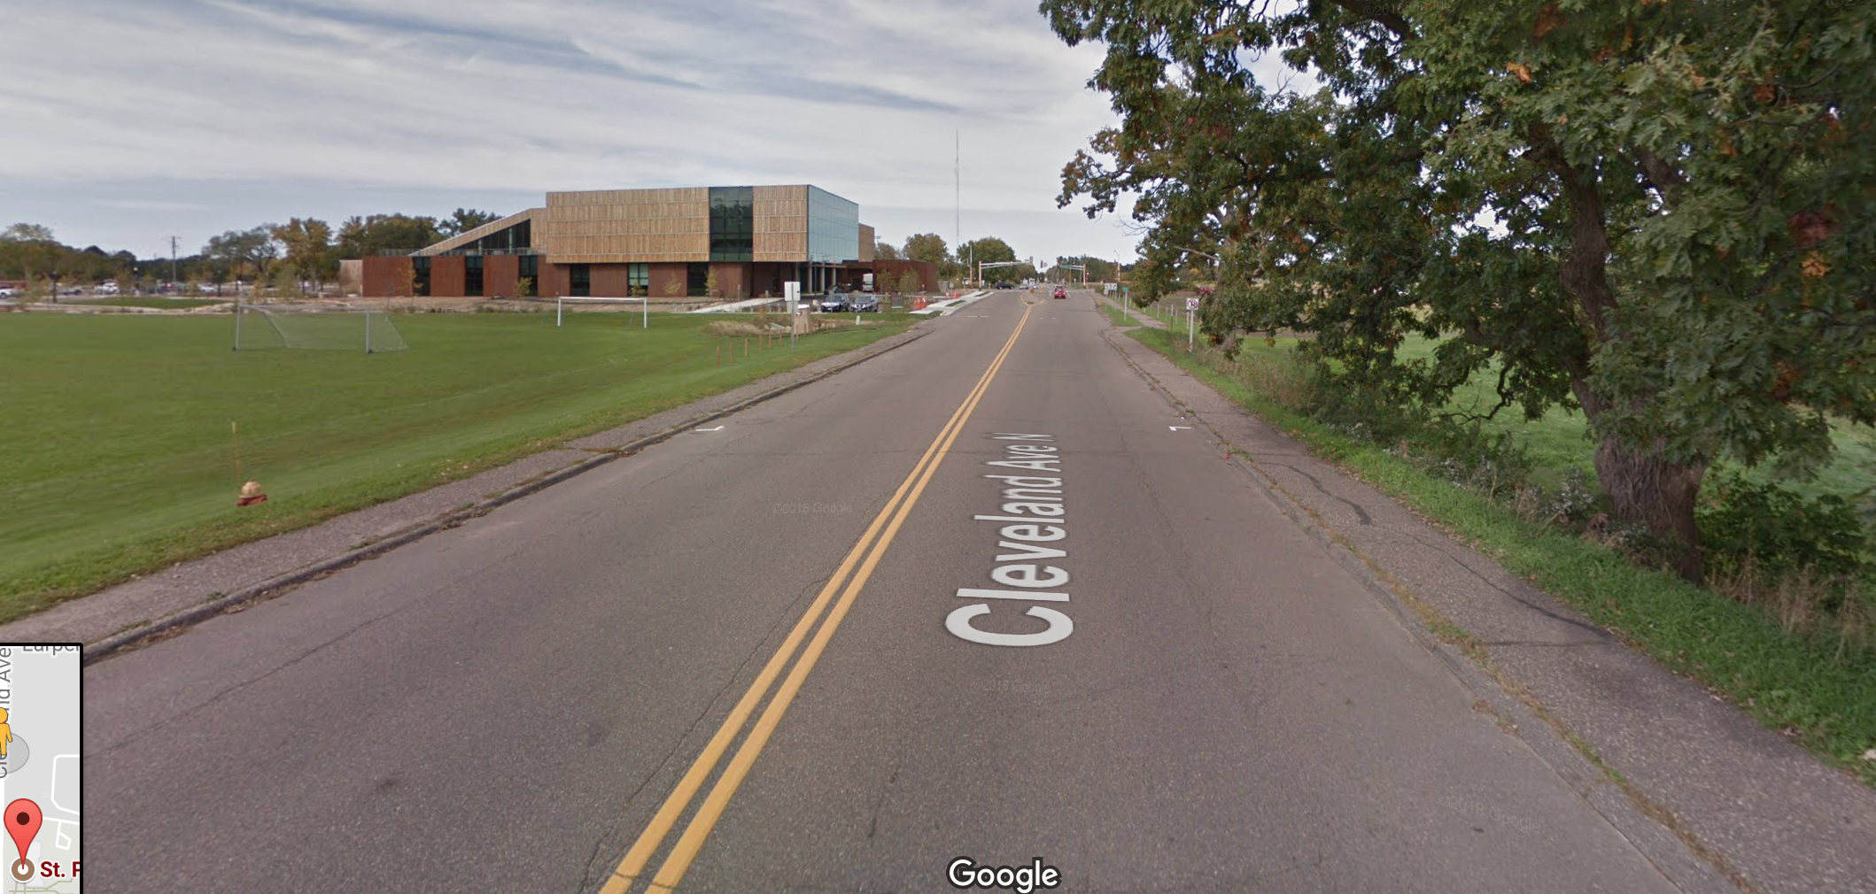

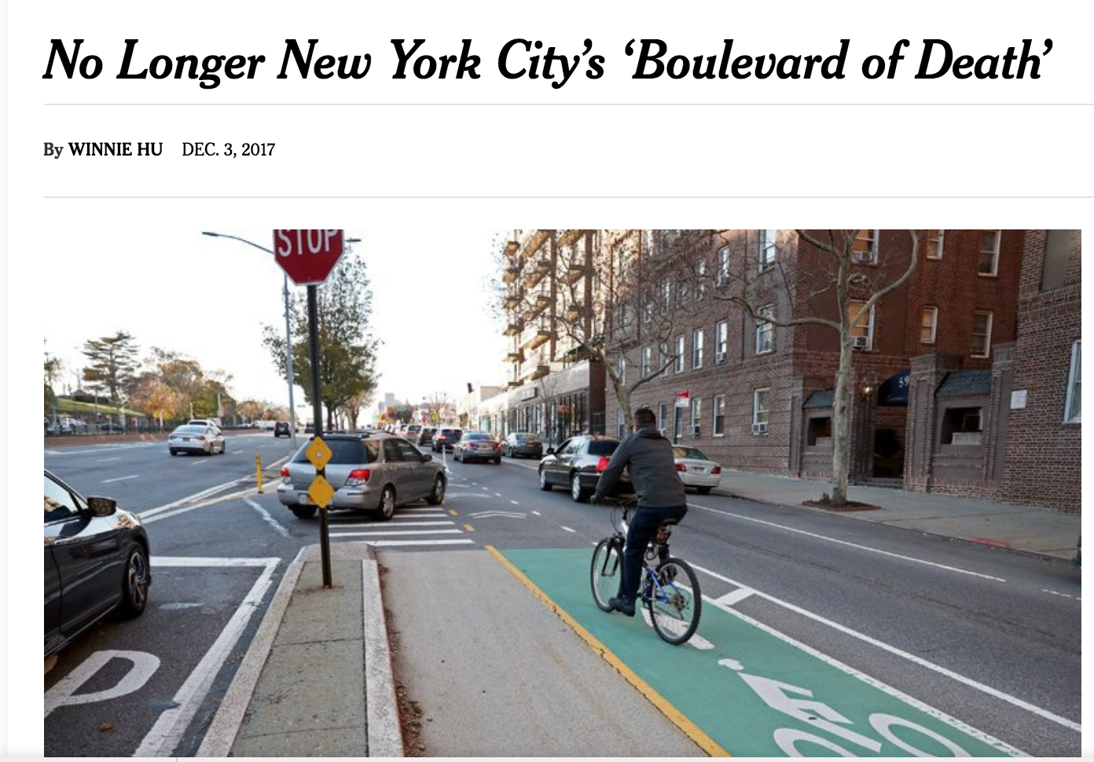
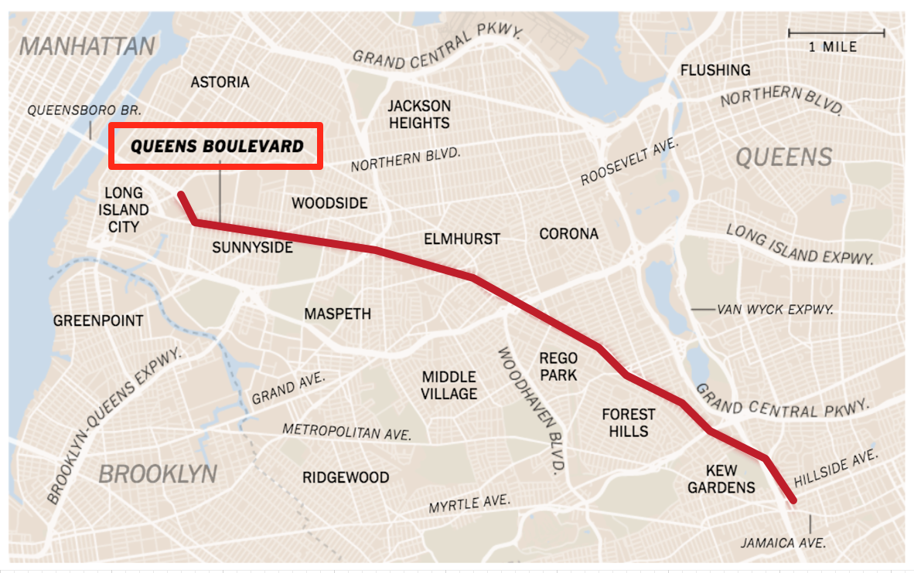
Motivation – Application
47,700 pedestrians killed in US from 2000-2009
Streets designed for traffic, not pedestrians
High speed arterial roads lack of infrastructures (e.g., sidewalks) account for majority of deaths
Provide transportation planners tools to identify roads that need better infrastructure
Another applications:
Disease hotspots along river
Crime (e.g., street robberies) hotspots
Pedestrian at risk on a road without proper sidewalks
https://www.nytimes.com/2017/12/03/nyregion/queens-boulevard-of-death.html

Slide 12
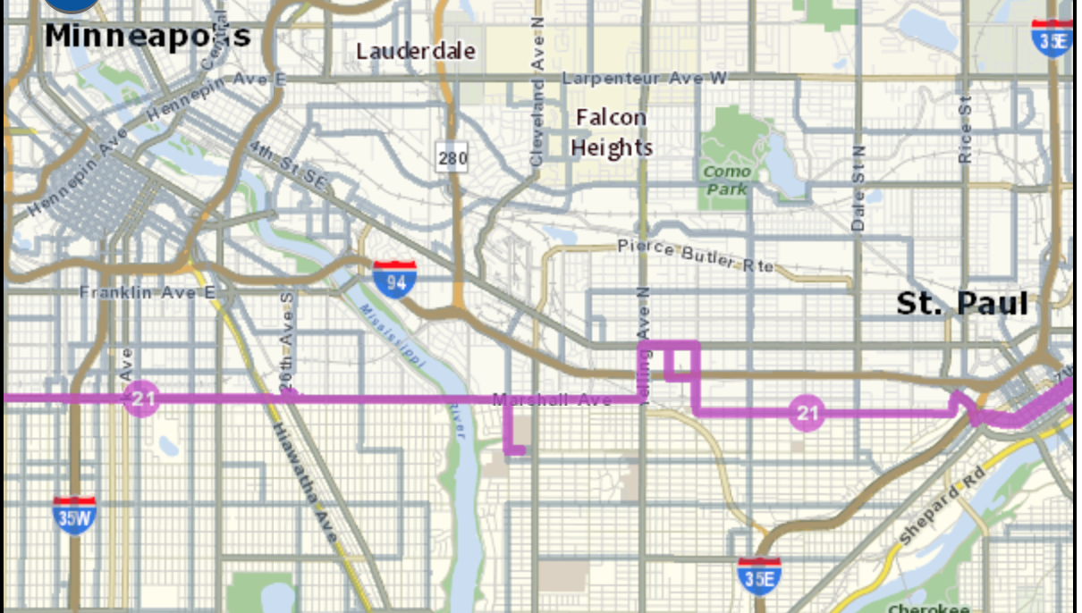
Motivation - why simple paths?
Our preliminary work investigates shortest paths assuming people always try to arrive destinations as soon as possible
Trade completeness of pattern for computational feasibility.
However, many routes are NOT shortest paths (e.g, bus routes and commuting routes)
All-simple-paths (paths without cycle) provide much richer pattern completeness.
Map of Metro Route 21

Slide 13
Outline
Motivation
Problem Statement
Challenges
Related Work
Contributions
Validation
Conclusion

Slide 14
Basic concepts
Y
Spatial network
Network nodes
(e.g., road intersections)
Edges
(e.g., roads)
Activities
Active edges: edges with activities
Active nodes: end nodes of active edges
Simple Path: Path without cycle
4
E
F
L
1
M
3
D
G
K
2
C
H
I
1
2
1
A
B
J
1
Example:
1
2
3
4
5
X
Start node | End node | Path
A | L
<A, B, C, H, L>
<A, B, C, H, I, K, M, L>
<A, B, C, H, I, J, H, L>
Not a simple path
…

Slide 15
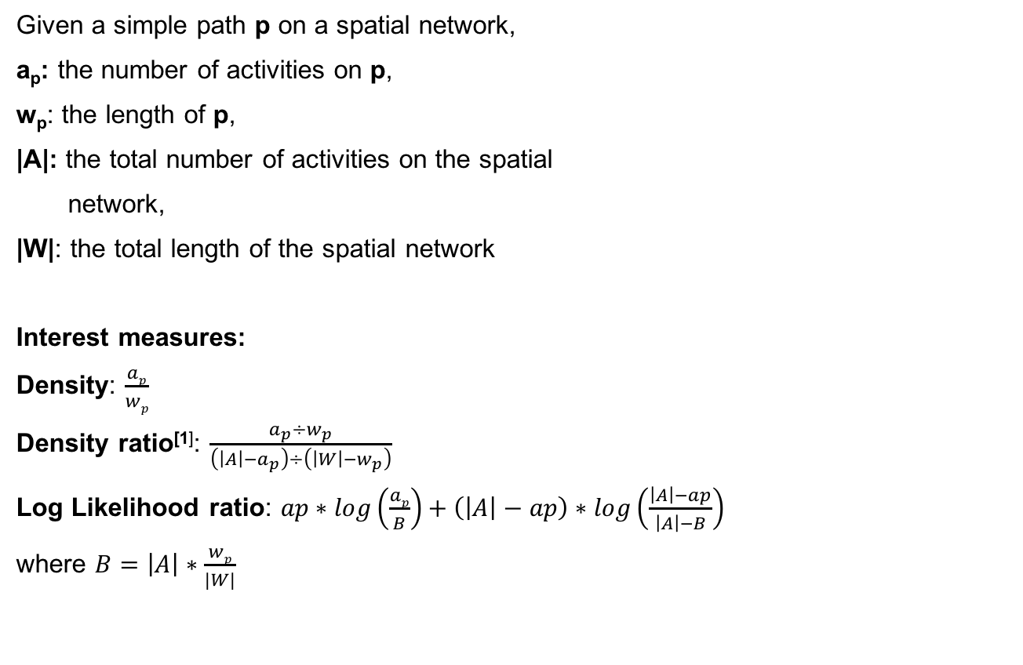
Basic concepts – interest measure
Y
4
E
F
L
1
M
Given a simple path p on a spatial network,
a_{p}: the number of activities on p,
w_{p}: the length of p,
|A|: the total number of activities on the spatial
network,
|W|: the total length of the spatial network
Interest measures:
Density: $\frac{ap}{wp}$
Density ratio^{[1]}: $\frac{a_{p}÷w_{p}}{\left(\left|A\right|−a_{p}\right)÷\left(\left|W\right|−w_{p}\right)}$
Log Likelihood ratio: $ap∗log\left(\frac{ap}{B}\right)+\left(\left|A\right|−ap\right)∗log\left(\frac{\left|A\right|−ap}{\left|A\right|−B}\right)$
where $B=\left|A\right|∗\frac{wp}{|W|}$
3
D
G
K
2
C
H
I
1
2
1
A
B
J
1
Used in this work
1
2
3
4
5
X
#
Simple path
Edge
# activities
Interest Measure | Value
Density | 0.40
Density Ratio | 3.59
Log likelihood ratio | 1.00
a_{p} | w_{p} | |A| | |W|
3 | 7.41 | 5 | 25.13
For Path <A, B, C, H, I, K, M, L>
Janeja, V. P., & Atluri, V. (2005, March). LS 3: A linear semantic scan statistic technique for detecting anomalous windows In Proceedings of the 2005 ACM symposium on Applied computing (pp. 493-497). ACM.

Slide 16
Problem Statement
Y
Given
A spatial network G = (N, E) with a set of activities A.
A density threshold θ_{d}
A p-value threshold θ_{p}
Find
All the simple paths P = {p_{i}} whose density d_{p} >= θ_{d}
and p-value <= θ_{p}
Objective
Computational efficiency
Constraints
Result simple path must start and end at active edges
Correctness and completeness
4
E
F
L
1
M
3
D
G
K
2
C
H
I
1
2
1
A
B
J
1
1
2
3
4
5
X
Example:
θ_{d} = 0.5, θ_{p} = 0.01
Start node | End node | Path | a_{p} | w_{p} | Density d_{p}
A | L
<A, B, C, H, L>
2
5.41
0.37
<H, L> is not an active edge
<A, B, C, H, I, K, M, L>
3
7.41
0.40
d_{p} < θ_{d}
<A, B, C, H, J, I, K, M, L>
5
8.82
0.57
Linear hotspot (p-value = 0.01)
…
…
…
…

Slide 17
Outline
Motivation
Problem Statement
Challenges
Related Work
Contributions
Validation
Conclusion

Slide 18
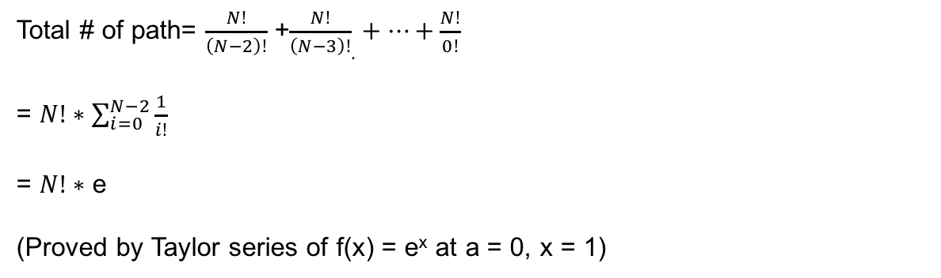
Challenges – large amount of simple paths
Given a complete graph that has N nodes, the number of simple paths (SPs) is exponential (#P-hard)
Total # of path= $\frac{N!}{\left(N−2\right)!}$ +${\frac{N!}{\left(N−3\right)!}}_{.}+⋯+\frac{N!}{0!}$
= $N!∗\sum_{i=0}^{N−2}{\frac{1}{i!}}$
= $N!∗$ e
(Proved by Taylor series of f(x) = e^{x} at a = 0, x = 1)
A
B
For example, a complete graph with 4 nodes has 60 simple paths
D
C
Notes:
fx=f（a）+f‘（a）/1!(x-a)+f''(a)/2!(x-a)^2+....
e^x=f(0)+f'(0)*x/1!+f''（0）x^2/2!+....
e=1+1/2!+1/3!+...1/n!

Slide 19
Outline
Motivation
Problem Statement
Challenges
Related Work
Contributions
Validation
Conclusion

Slide 20
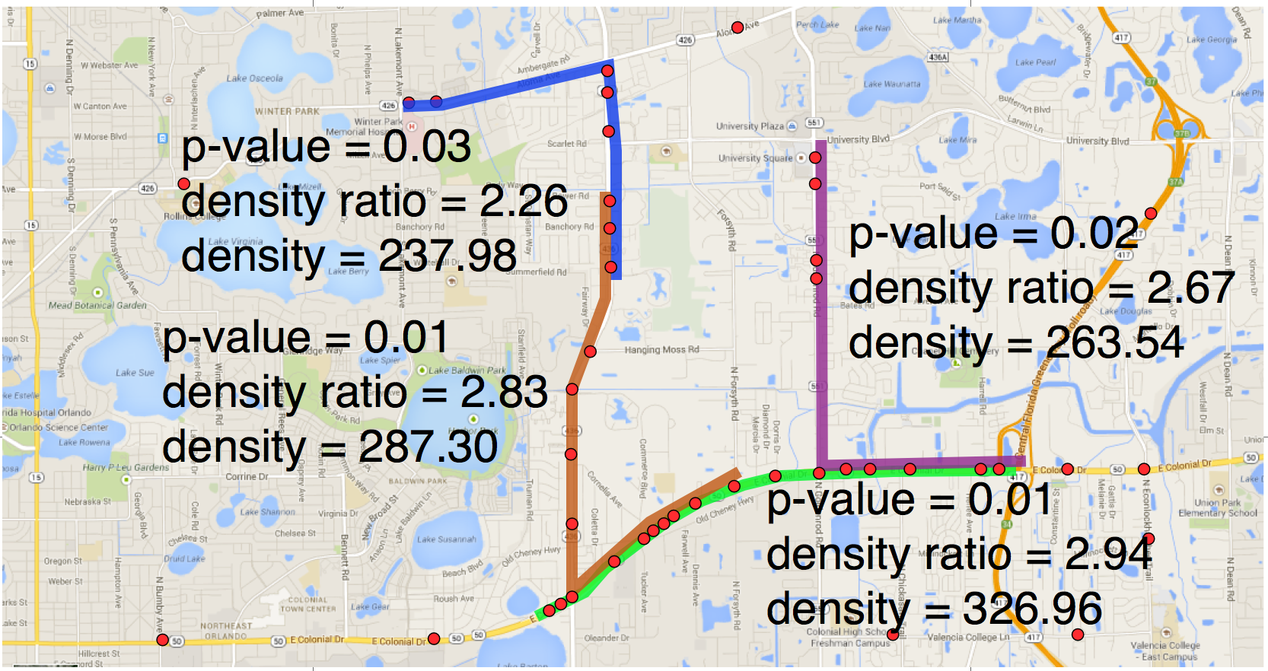
Related work
Spatial Hotspots Detection
Consider spatial network and enumerate all simple path
No
Yes
Consider spatial networks
Simple path linear hotspots (proposed)
No
Yes
Circular [1],
Ellipse [1, 3],
Rectangular [8],
Ring [6],
Flexible shape [7]
Shortest paths only
No
Yes
Iso-distance sub-network [2],
Simple paths hotspots in tree [9],
Hot-routes detection[11]
Shortest path linear [4, 5],
K-main routes [10]
SatScan
Shortest paths
Simple paths

Slide 21
Outline
Motivation
Problem Statement
Challenges
Related Work
Contributions
Validation
Conclusion

Slide 22
Contributions - overview
Formally define the problem of Linear Hotspot Discovery on All-Simple-Paths (ASP)
Propose a baseline algorithm using depth-first-search with backtracking
Propose several novel algorithms that substantially improve computational efficiency:
Baseline approach (ASP_Base)
Baseline algorithm using
depth-first-search with backtracking
Prune-and-refine framework, divide and conquer
Partition the spatial network
Compute and re-use information in each fragment by a
bi-directional traversal
Bi-directional Fragment-Multi-Graph Traversal (ASP_FMGT)
Mono-directional Fragment-Multi-Graph Traversal (ASP_FMGT_MONO)
Further reduce the cost of ASP_FMGT by:
Reduce bi-directional to mono-directional traversal
More effective pruning using tighter upper-bound
Non-repeated FMG-node path reduction (ASP_NR)
Highest density paths in FMG-node path reduction (ASP_HD)
Path reduction approaches
Only consider representative paths from all simple paths
Validation:
Theoretical
Experimental
New after
thesis proposal

Slide 23
Baseline algorithm using depth-first-search with backtracking (ASP_Base)
Main idea: starting from each active node as root, run depth-first-search with backtracking.
Given an input network with 4 nodes, 6 edges, and 6 activities:
A
1
B
Root = A
Root = B
1
1
1
1
A
B
D
1
C
B
C
D
A
C
D
C
D
B
D
B
C
C
D
A
D
A
C
D
C
C
D
D
C
D
A
C
A
C
D
B
Time complexity = O(N!)
Space complexity = O(N)
There are redundant computations

Slide 24
Bi-directional Fragment-Multi-Graph Traversal approach (ASP_FMGT): divide and conquer
Key idea: divide-and-conquer
Re-use information computed in graph partitions
ASP_FMGT follows a prune-and-refine framework:
Construct and prune a much smaller Fragment-multi-graph graph (prune phase)
Enumerate and evaluate simple paths on pruned graph (refine phase)
Steps of ASP_FMGT:
Step 1: Partition the spatial network into fragments and make Fragment-multi-graph (FMG)
Y
Fragment-multi-graph (FMG)
4
E
F
L
1
M
z
y
Note:
Any network partitioning approaches can be used
we use rectangular partitioning for simplification
F
L
K
D
G
K
G
3
z
y
2
C
H
I
C
H
I
1
2
w
x
1
A
B
w
x
J
1
w
FMG-node
1
2
3
4
5
X

Slide 25
ASP_FMGT: build FMG-trees
Steps of ASP_FMGT:
Step 1: Partition the spatial network into fragments (sub-graphs)
and make Fragment-multi-graph (FMG)
Step 2: Build FMG-trees rooted at each FMG-node by run depth-first-search on FMG
The FMG-tree with Root = FMG-node y:
Fragment-multi-graph
L
y
K
F
L
I
x
H
C
z
y
z
H
C
F
L
K
F
G
w
G
x
H
F
C
H
L
C
z
C
I
C
y
G
F
w
z
C
C
w
w
L
L
C
H
I
K
C
F
w
x
C
y
C
F
L
y
H
G
G
x
H
F
z
y
z
z
G
I
x
z
F
FMG-node
C
w
I
C
K
w
w
K
y
y
C
G
z

Slide 26
ASP_FMGT: prune FMG-trees
Steps of ASP_FMGT:
Step 1: Partition the spatial network into fragments (sub-graphs) and make FMG
Step 2: Build FMG-trees rooted at each FMG-node
Step 3: Traverse each FMG-tree in a bi-directional manner with pruning
Step 3.1 bottom-up: each FMG-node recursively gathers information from kids
Step 3.2 top-down: prune each tree using upper-bound density
Step 4: Refine phase: enumerate and evaluate ASP based on pruned FMG-tree
The FMG-tree with Root = FMG-node y:
In bottom-up run, each FMG-node collect the upper-bound density from all its descendants
(1) upper-bound density of the not visited part
In top-down run, each sub-tree is determined whether pruned using the maximum value of:
(2) upper-bound density of the already-visited part
By max { (1), (2) }, FMG-node is pruned:
2
L
y
K
1
L
I
F
H
1
1
z
H
1
x
C
F
G
w
C
1
x
H
1
C
F
1
C
H
L
z
w
1
C
I
C
1
y
G
F
w
1
z
L
C
C
K
w
C
L
F
C
y
C
F
1
L
y
1
H
G
G
x
z
H
F
z
z
y
x
z
F
G
Let density threshold = 1.5, we have the pruned FMG-tree:
I
1
C
I
C
K
K
K
w
w
L
y
y
1
y
C
F
L
I
G
H
x
z
z
x

Slide 27
Mono-directional FMGT (ASP_FMGT_Mono): intuition
Recall steps of ASP_FMGT:
Step 1: Partition the spatial network into fragments (sub-graphs) and make FMG
Step 2: Build FMG-trees rooted at each FMG-node
Step 3: Traverse each FMG-tree in a bi-directional manner with pruning
Step 3.1 bottom-up: each FMG-node recursively gathers information from kids
Step 3.2 top-down: prune each tree using upper-bound density
Step 4: Refine phase: enumerate and evaluate ASP based on the pruned FMG-tree
Removed
The upper-bound used in ASP_FMGT is max { (1), (2) }:
(1) upper-bound density of the not visited part of FMG-path
(2) upper-bound density of the already-visited part of FMG-path (FMG-node level)
Thus, ASP_FMGT_Mono uses a tighter upper-bound which is max { (1), (3) }:
(1) upper-bound density of the not visited part of FMG-path
(3) density of already-visited part of path (network-node level) determined in refine phase
Lemma: value of (3) always <= value (2)
Computational cost saves from two directions:
Abandon the total cost of traversing an FMG-tree
Pruning is more aggressive from tighter upper-bound

Slide 28
ASP_FMGT_Mono vs. ASP_FMGT: Example
Y
FMG-tree with root = FMG-node y:
4
E
F
L
1
M
2
3
D
G
z
y
K
L
y
K
F
L
I
1
1
x
H
C
1
z
H
1
w
C
2
C
H
I
F
G
x
H
F
1
C
H
L
1
C
z
1
2
1
w
1
C
I
C
y
G
F
A
B
w
x
J
w
1
1
z
L
1
1
C
C
K
w
C
L
F
C
y
C
F
L
y
H
G
G
1
1
2
3
4
5
X
x
z
H
F
z
z
y
1
x
F
G
I
z
C
Refine phase of ASP_FMGT starting
from Node L
I
1
C
w
K
K
1
w
L
y
y
max{0,1}
max{0,1}
max{0,1}
C
1
G
F
H
M
K
z
0.5
E
G
I
J
K
I
Given density threshold = 1.5, ASP_FMGT prunes it to:
max{0.33,1}
D
D
J
I
I
J
L
y
K
H
F
L
I
H
J
H
G
E
J
H
z
x
x
In ASP_FMGT_Mono,
refine phase is early terminated
J
H

Slide 29
ASP_FMGT_Mono vs. ASP_FMGT: Example (2)
Y
FMG-tree with root = FMG-node y:
4
E
F
L
1
M
2
3
D
G
z
y
K
L
y
K
F
L
I
1
1
x
H
C
1
z
H
1
w
C
2
C
H
I
F
G
x
H
F
1
C
H
L
1
C
z
1
2
1
w
1
C
I
C
y
G
F
A
B
w
x
J
w
1
1
z
L
1
1
C
C
K
w
C
L
F
C
y
C
F
L
y
H
G
G
1
1
2
3
4
5
X
x
z
H
F
z
z
y
1
x
F
G
I
z
C
I
1
C
w
K
K
1
w
In contrast, the number of simple paths enumerated by ASP_FMGT_Mono is still small
due to the tighter upper-bound
y
y
C
G
z
L
Given density threshold = 1, ASP_FMGT does not prune anything
F
H
M
K
K

Slide 30
Path reduction approaches - intuition
Still expensive even though ASP_FMGT_Mono further reduces the cost (#p-hard)
How to further scale up the solution?
Observation:
Enumerated simple paths are:
back-and-forth, not really meaningful
very similar to each other (e.g., shared large portion)
Methods:
“Non-repeated FMG-node” paths reduction for prune phase in ASP_FMGT_Mono (ASP_NR)
Only consider simple paths without repeated FMG-node
“Highest density paths in FMG-node” paths reduction for refine phase in ASP_FMGT_Mono (ASP_HD)
For simple paths between each pair of boundary nodes in a FMG-node, only consider the one with highest density
Results depend on the resolution of partitioning
Equivalent to all simple paths if every fragment contains only one node.
Only one path that has the highest density is considered if there are only one fragment

Slide 31
Non-repeated FMG-node paths reduction (ASP_NR)
Only consider simple paths without repeated FMG-node
L
y
K
F
L
I
x
H
C
y
K
z
H
w
C
L
F
G
H
F
F
L
I
C
x
H
L
C
z
x
H
C
C
I
y
G
z
H
w
C
w
C
z
F
F
G
F
C
C
w
K
w
L
F
L
C
x
H
C
z
C
C
F
y
C
C
G
H
G
y
C
G
L
w
z
H
y
C
w
w
x
z
F
z
z
C
x
F
G
C
C
I
z
C
H
G
I
C
x
H
F
z
K
w
w
x
K
z
y
y
C
G
z

Slide 32
Highest density paths in FMG-node paths reduction (ASP_HD)
For simple paths between each pair of boundary nodes in a FMG-node, only consider the one with highest density
Simple paths rooted at node FMG-node y
using ASP_NR + ASP_HD:
L
M
L
y
K
M
F
L
I
L
x
H
C
z
H
C
F
G
w
F
F
K
C
x
H
C
z
H
C
C
G
C
G
w
z
I
C
w
w
C
C
C
H
C
H
C
G
H
F
J
x
z
H
F
G
x
z
I
Y
H
J
I
4
E
F
L
1
M
C
J
3
D
G
z
y
K
F
G
Number of simple paths rooted at node FMG-node y:
2
C
H
I
Approach | ASP_FMGT (no pruning) | ASP_NR | ASP_HD | ASP_NR + ASP_HD
# simple path | 1500 | 800 | 32 | 23
1
2
1
A
B
w
x
J
1
1
2
3
4
5
X

